Slide 1

Embedded Systems Internship
Presented by
G . Jai Anjaneya
(22A91A0476)
Electronics and Communication Engineering
Aditya University

Slide 2
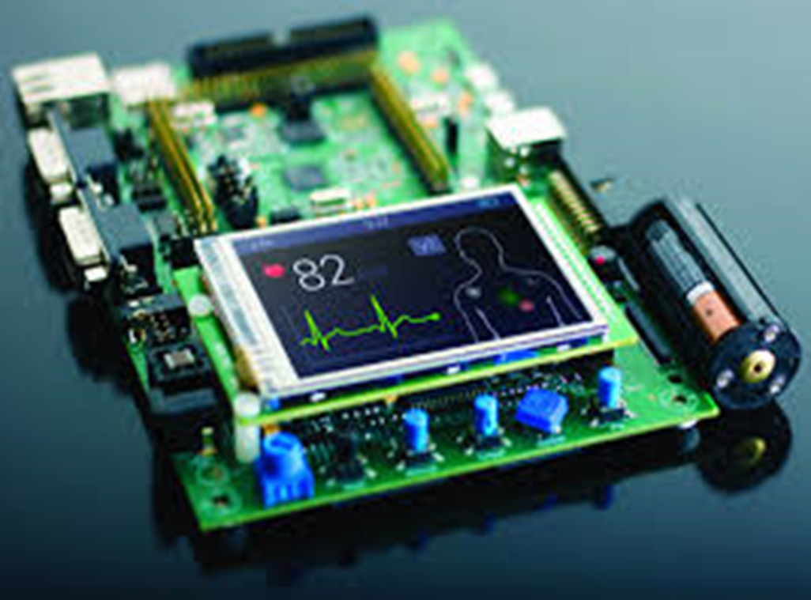
Embedded System
A device which has a programmable computer but not intended to be a general purpose computer

Slide 3
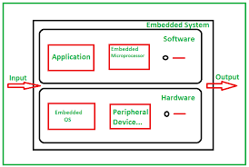
Embedded system
A system which has computer hardware with software embedded in it

Slide 4
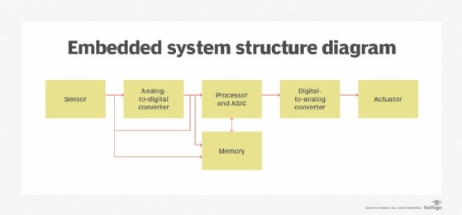

Slide 5
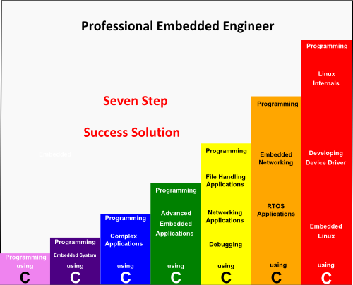
Embedded Systems Engineer:
Content:
Role: Develops software and hardware for embedded systems integrated into electronic devices.
Key Responsibilities: Writing firmware, developing microcontroller applications, and hardware-software integration.
Skills Required: Proficiency in programming languages (C/C++), knowledge of microprocessors, and real-time operating systems.

Slide 6
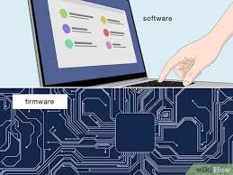
Firmware
A fixed software which cannot be modified

Slide 7
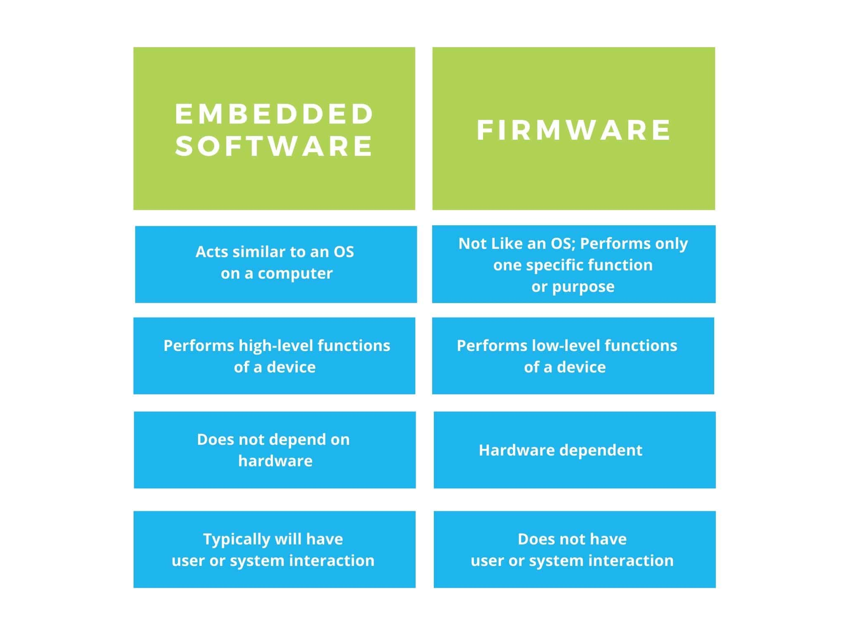

Slide 8
PROJECT
ROBOT OPERATION USING
SWITCHES BY ARDUINO

Slide 9



Block Diagram
Switch1
Switch2
Switch3
Switch4
ROBOT

Slide 10
ABSTRACT
The main aim of this project is to operate the ROBOT using switches by Arduino.

Slide 11
Introduction to Robots
Robotics it is man-made mechanical devices that can move by themselves, whose motion must be planned,sensed, actuated, modeled and controlled, and whose motion behavior can be influenced by programming. Robots are the physical agent that perform task by
manipulating the physical world.
Robots are the physical agent that perform task by manipulating the physical world.

Slide 12
Robot hardware Requirement
Components:
Microcontroller
Arduino Uno (or equivalent): The main control board.
Robot Structure
Chassis: The frame to hold the components (2-wheel, 4-wheel, or custom chassis).
Motors:
Wheels: For the robot's mobility.
Caster Wheel: (Optional) To stabilize the robot.

Slide 13
Switch Input
Push Buttons or Toggle Switches: For user inputs to control the robot.
Pull-Down Resistors (e.g., 10k Ohm): To stabilize the button input signals.
Motor Control
Motor Driver Module (e.g., L298N or L293D): To drive the motors.
Power Supply
Battery Pack (e.g., 9V or 12V with proper capacity for motors and Arduino).
Power Wires: To connect the power supply.
Additional Components
Jumper Wires: For wiring connections.
Breadboard: For prototyping.
On/Off Switch: To power the system on and off.

Slide 14
What is an Arduino Uno used for?
Arduino UNO is a low-cost, flexible, and easy-to-use programmable open-source microcontroller board that can be integrated into a variety of electronic projects . This board can be interfaced with other Arduino boards, Arduino shields, Raspberry Pi boards and can control relays, LEDs and motors as an output.

Slide 15
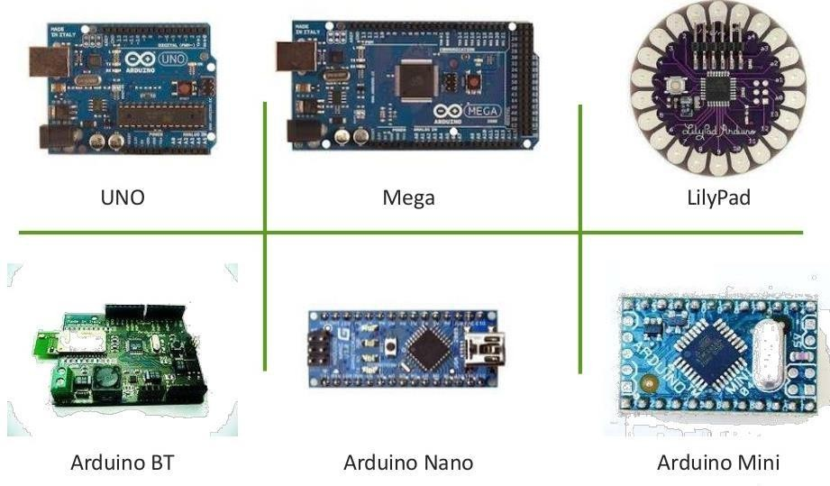
Arduino Boards

Slide 16
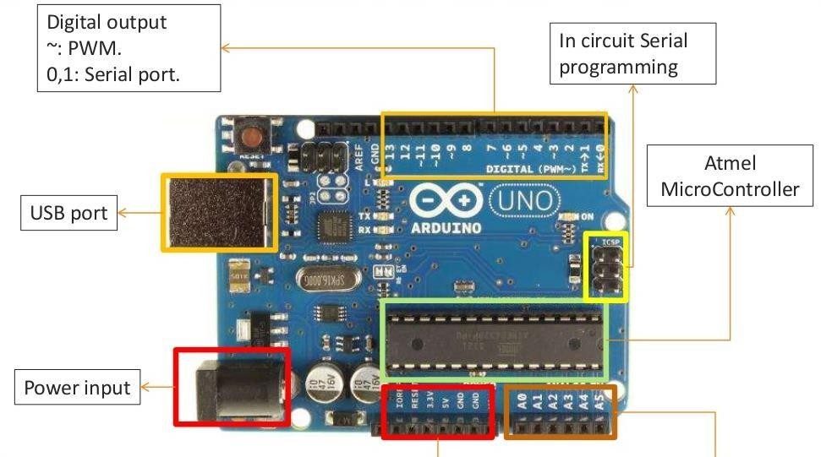
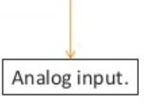

Arduino UNO

Slide 17
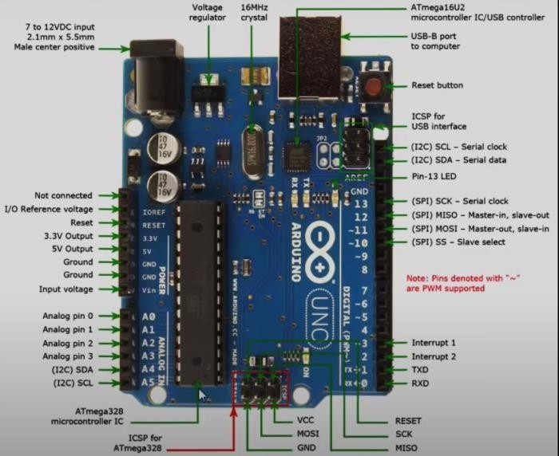

Slide 18
Controllers
Controllers direct a robot how to move.
Open-loop controllers:
open loop controller feedback.
Closed-loop controllers:
executes
robot
movement
without
closed loop controller executes robot movement and judge progress with sensors. They can thus compensate for errors

Slide 19
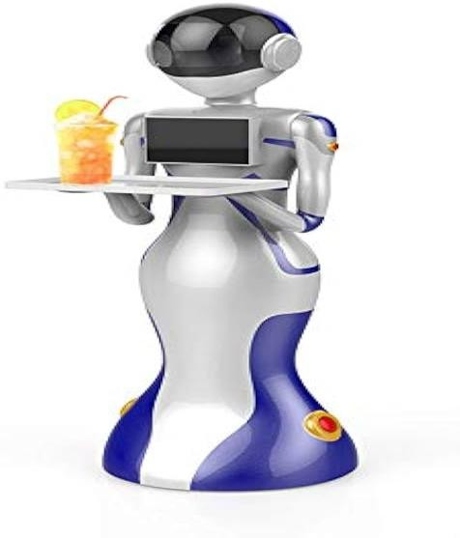
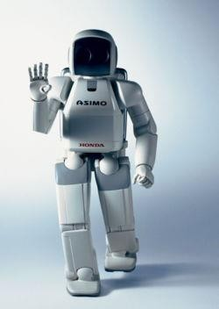
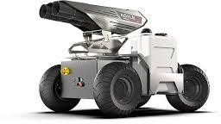
Robot’s types and their Application area
Mobile Robots:
Mobile robots move about their environment using wheels, legs, or similar mechanism. They are used for delivering food in hospitals, moving the containers and similar tasks like this. They perform tasks such as searching. They are of 2 types
Rolling robots:
Walking robots

Slide 20
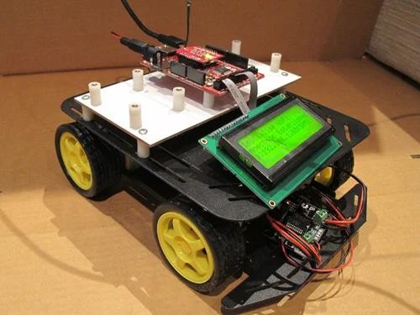
Educational robotics
Educational Robot is learning environment in which the people involved are motivated by the design and construction of creations

Slide 21
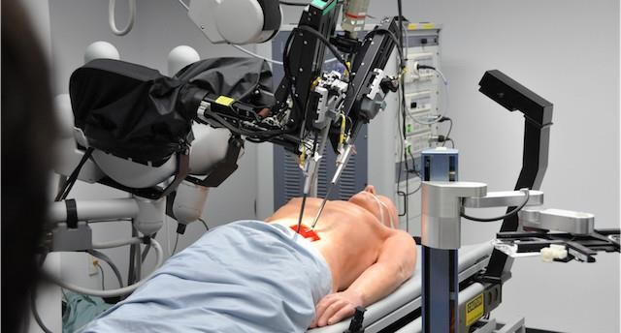
Medical robots
Robots employed in medicine and medicinal institutes. These are first and foremost surgical treatment robots. Also, a number of robotic directed automobiles and perhaps lifting supporters.

Slide 22
Advantages of robotics
You can send them to very dangerous places.
You can make them do the job of your own.
They are more accurate than humans.
They can do jobs of every type and can do any task easily.
They can guard without being tired just keep doing the same thing again and again without getting bored.
No need of nutrients, food etc.
Robots do not get sick, they can work 24/7 without complaining

Slide 23
Disadvantages
You need to get people trained to make them and to fix them if anything wrong happens.
Need a very intelligent crew( a group of people working together)
They can ruin people’s lives like take their job away from them.
They are very expensive to make.
You need the right materials to make them that could be very rare.
No guarantee of doing work complete may be a failure can occur in it.
It takes time to train robots

Slide 24
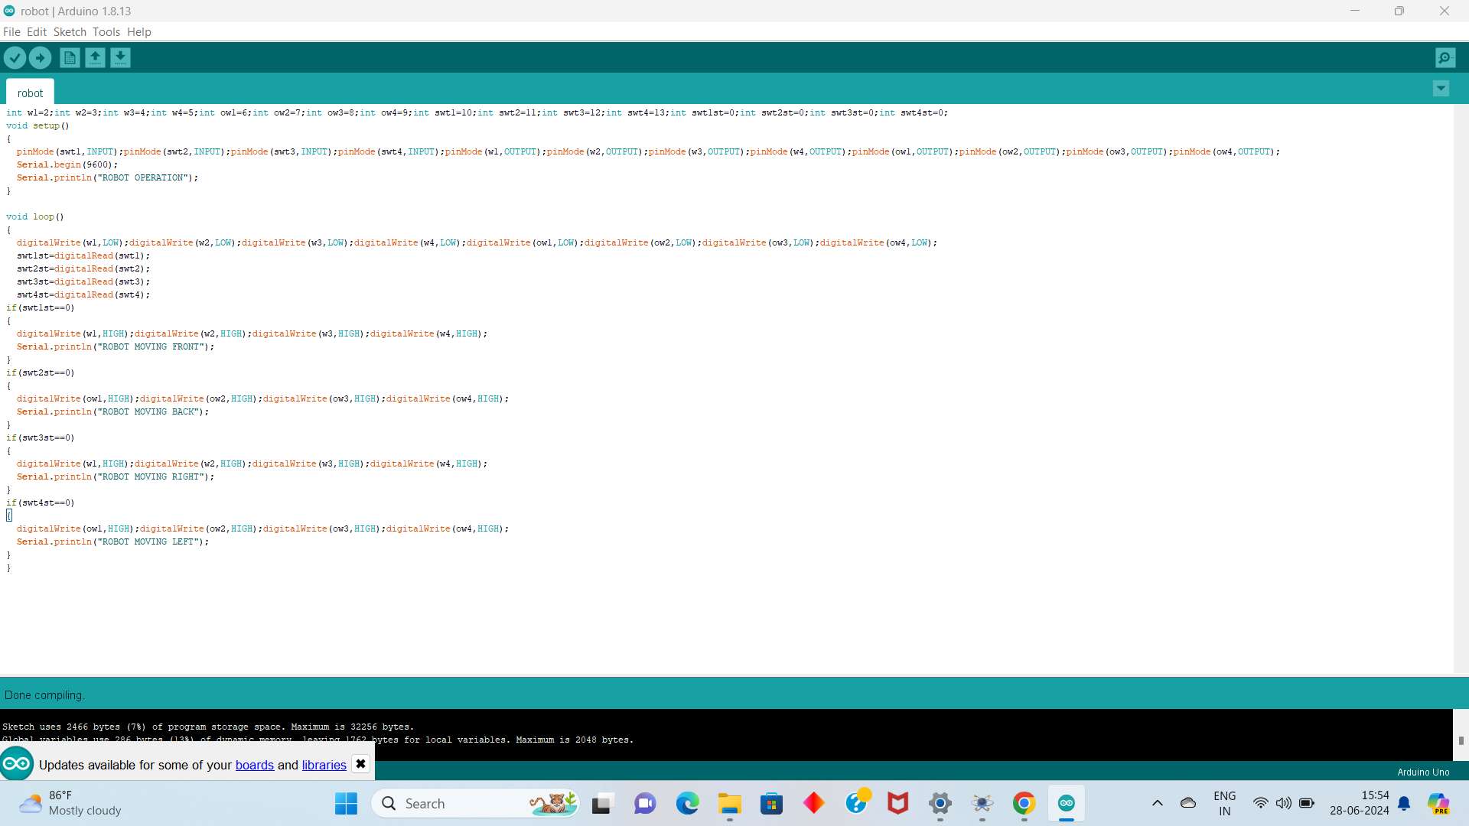
Software: Arduino IDE

Slide 25
Soft code
int w1=2;int w2=3;int w3=4;int w4=5;
int ow1=6;int ow2=7;int ow3=8;int ow4=9;
int swt1=10;int swt2=11;int swt3=12;int swt4=13;
int swt1st=0;int swt2st=0;int swt3st=0;int swt4st=0;
void setup()
{
pinMode(swt1,INPUT);pinMode(swt2,INPUT);pinMode(swt3,INPUT);pinMode(swt4,INPUT);
pinMode(w1,OUTPUT);pinMode(w2,OUTPUT);pinMode(w3,OUTPUT);pinMode(w4,OUTPUT);
pinMode(ow1,OUTPUT);pinMode(ow2,OUTPUT);pinMode(ow3,OUTPUT);pinMode(ow4,OUTPUT);
Serial.begin(9600);
Serial.println("ROBOT OPERATION");
}

Slide 26
Soft code
void loop()
{
digitalWrite(w1,LOW);digitalWrite(w2,LOW);digitalWrite(w3,LOW);digitalWrite(w4,LOW);
digitalWrite(ow1,LOW);digitalWrite(ow2,LOW);digitalWrite(ow3,LOW);digitalWrite(ow4,LOW);
swt1st=digitalRead(swt1);
swt2st=digitalRead(swt2);
swt3st=digitalRead(swt3);
swt4st=digitalRead(swt4);
if(swt1st==0)
{
digitalWrite(w1,HIGH);digitalWrite(w2,HIGH);digitalWrite(w3,HIGH);digitalWrite(w4,HIGH);
Serial.println("ROBOT MOVING FRONT");
}

Slide 27
Soft code
if(swt2st==0)
{
digitalWrite(ow1,HIGH);digitalWrite(ow2,HIGH);digitalWrite(ow3,HIGH);digitalWrite(ow4,HIGH);
Serial.println("ROBOT MOVING BACK");
}
if(swt3st==0)
{
digitalWrite(w1,HIGH);digitalWrite(w2,HIGH);digitalWrite(w3,HIGH);digitalWrite(w4,HIGH);
Serial.println("ROBOT MOVING RIGHT");
}
if(swt4st==0)
{
digitalWrite(ow1,HIGH);digitalWrite(ow2,HIGH);digitalWrite(ow3,HIGH);digitalWrite(ow4,HIGH);
Serial.println("ROBOT MOVING LEFT");
}
}

Slide 28
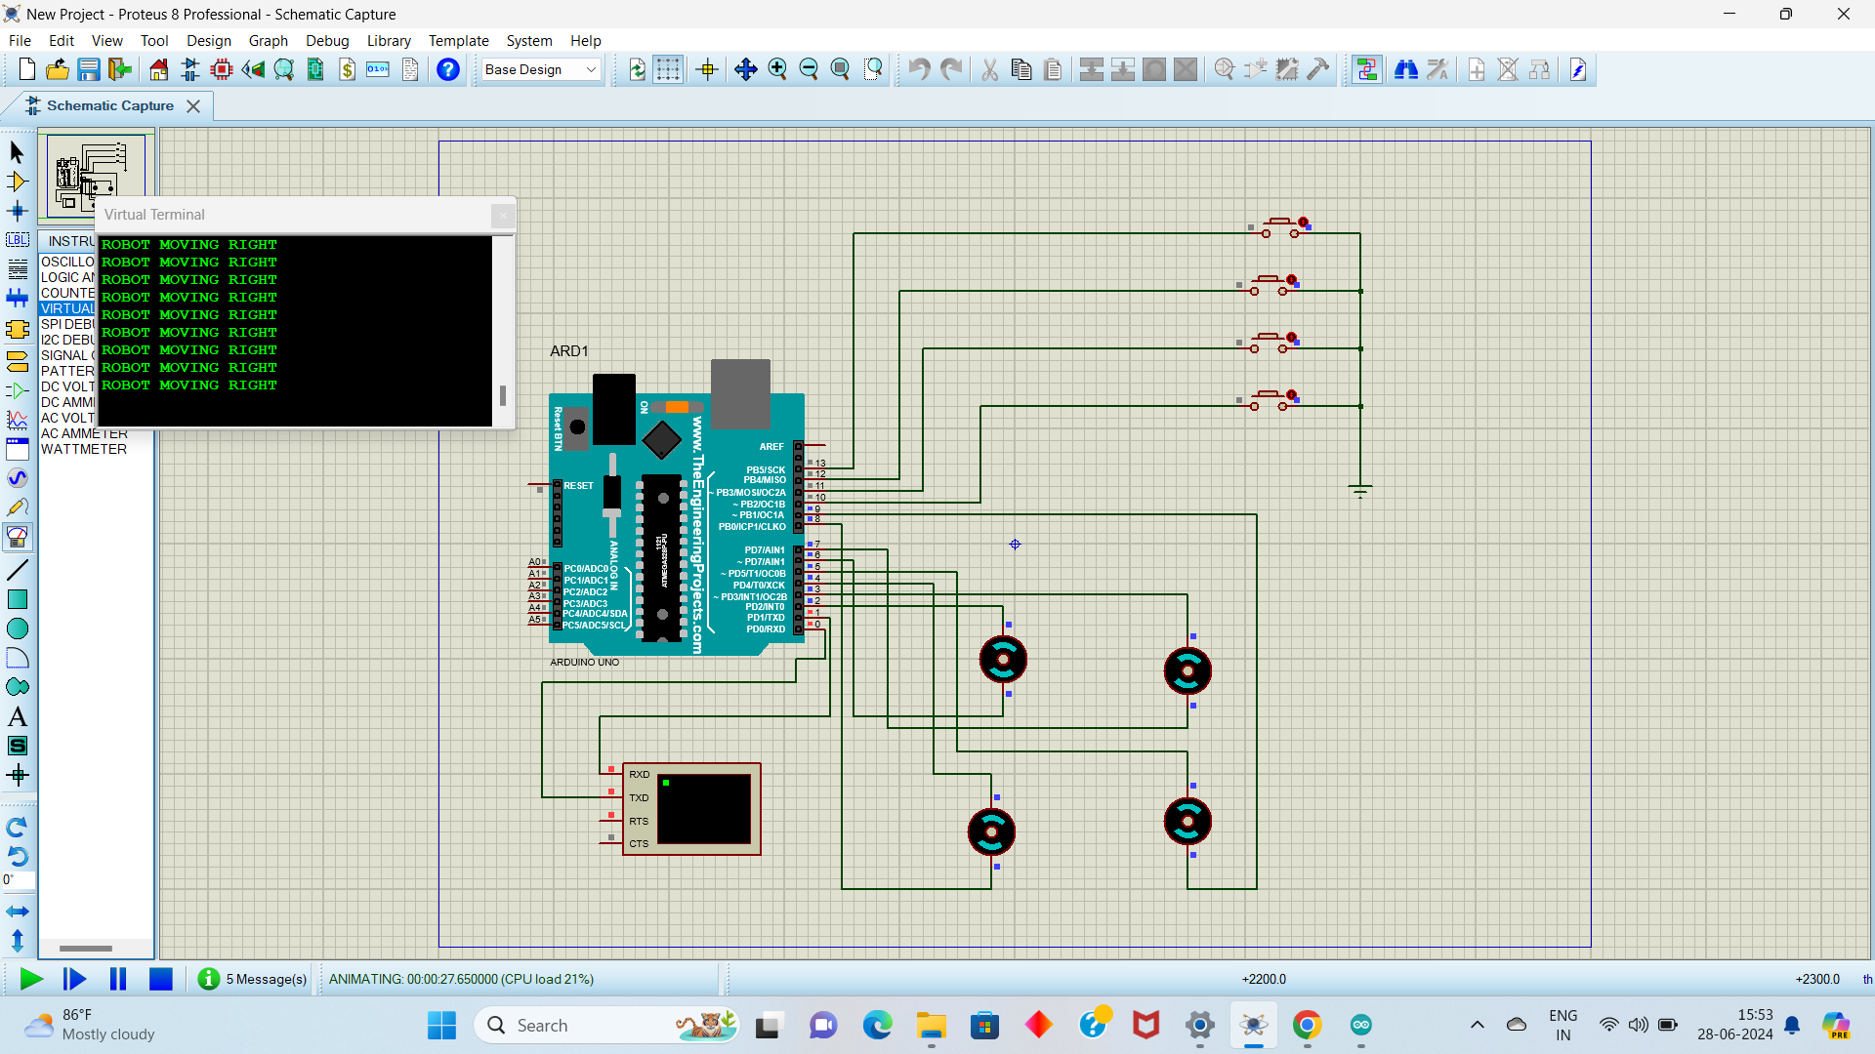
Hardware Connection using Proteus
https://github.com/users/Anjigampala/projects/1/views/1

Slide 29
LINK
https://github.com/Anjigampala/embedded-System.git

